Slide 1


How to Maintain Your
At-Home Garden
Tips for Healthy, Thriving Plants
Selena M Saenz

Slide 2
Why Home Gardening?
Fresh Produce
Mental Wellness
Sustainability

Slide 3
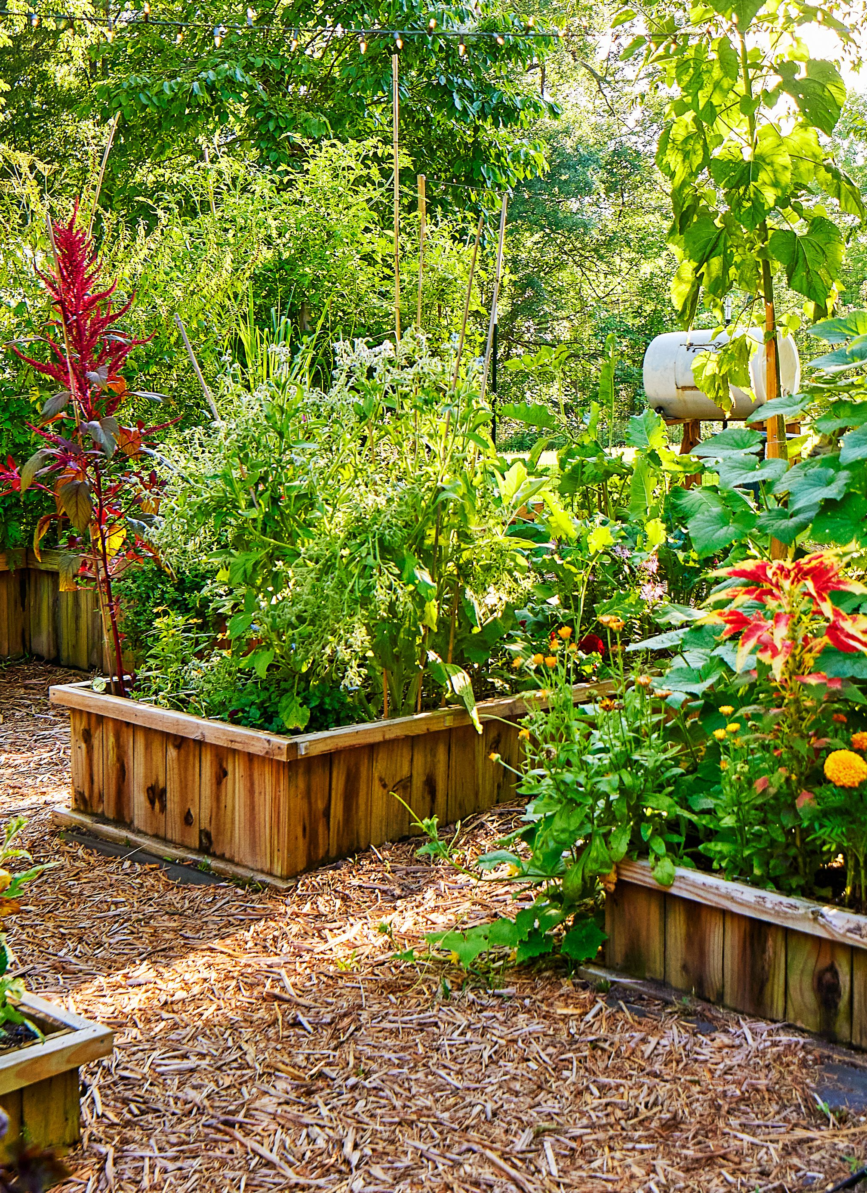
Choose Your Style
Container Gardens
Raised Beds
Indoor Herb Gardens
Balcony or Vertical Gardens
Traditional Backyard Garden

Slide 4
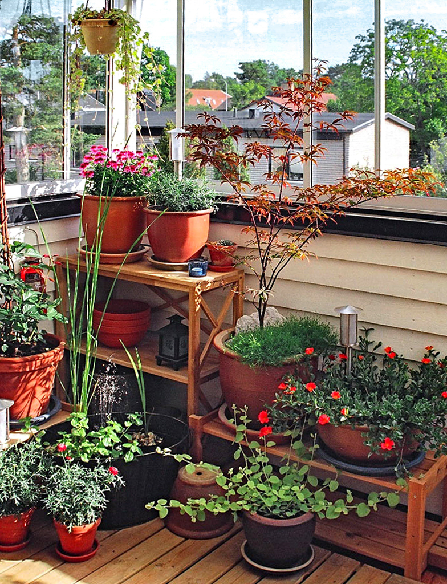
The Power of the Sun
Most vegetables and flowers need 6-8 hours of direct sunlight
For indoor setups place your plants near a south facing window for best results
  Rotate indoor plants for even growing

Slide 5
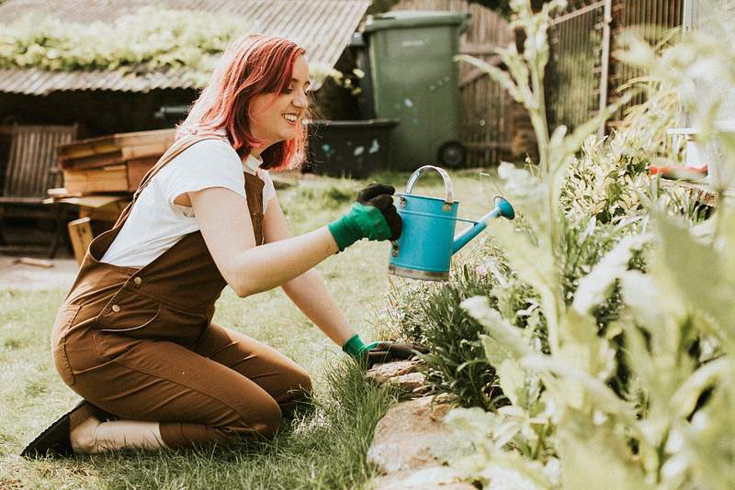
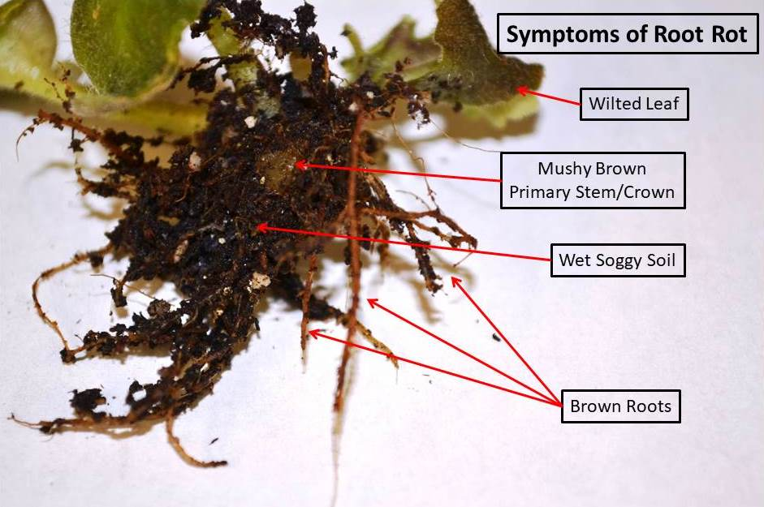
Watering Wisely
Check soil before watering (If dry 1-inch below surface = time to water)
Water in the early mornings or late afternoons
Avoid overwatering – root rot is very common
  A plant disease where roots decay due to a lack of oxygen, typically from overwatering and poor drainage
Use self-watering pots or a drip irrigation for consistency

Slide 6
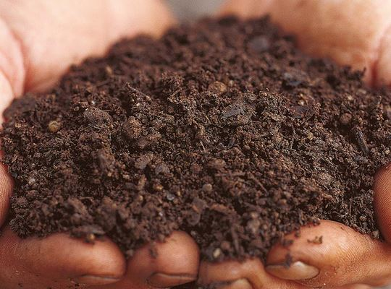
Boosting Soil Life
Use high quality potting mix or compost rich soil
If possible, test the pH if you plan on growing fruits and veggies
  There are websites that can help the pH balance you're looking for
  How to Test Soil pH With and Without a Kit
Add organic compost regularly
Add mulch if you want to retain moisture and reduce weeds
This Photo by Unknown Author is licensed under CC BY-NC-ND

Slide 7
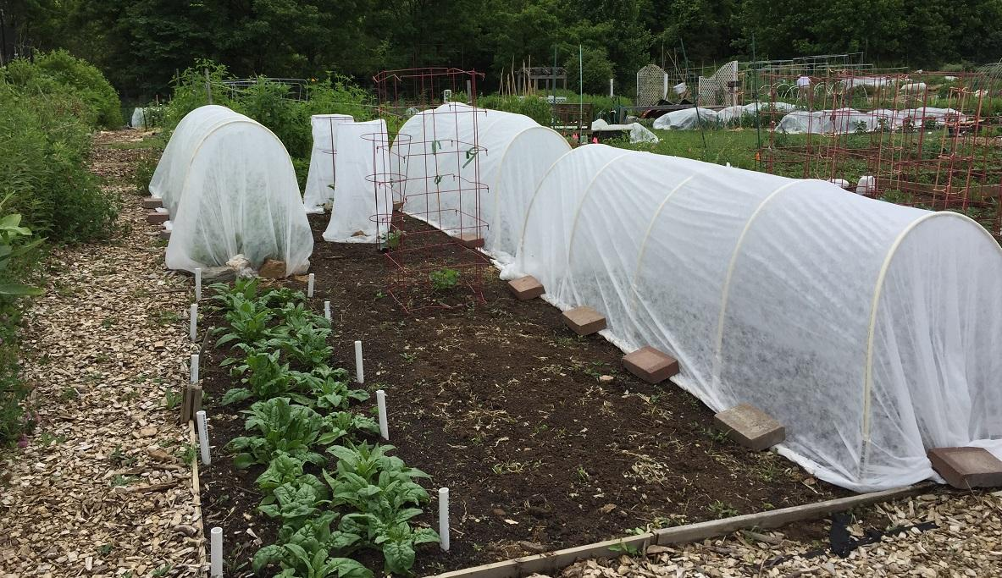
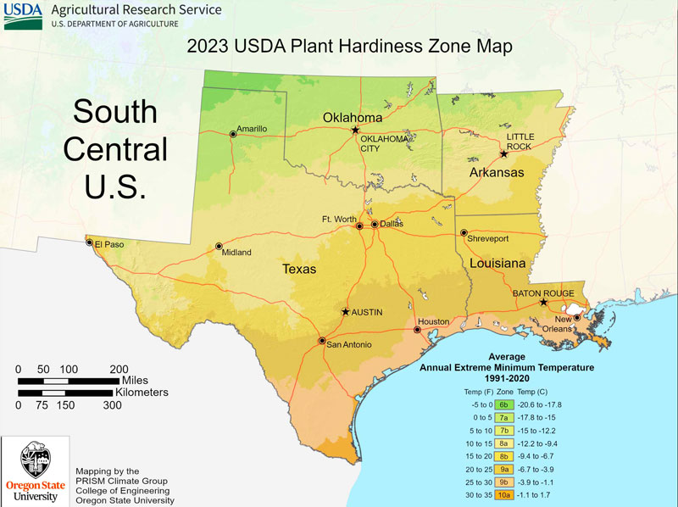
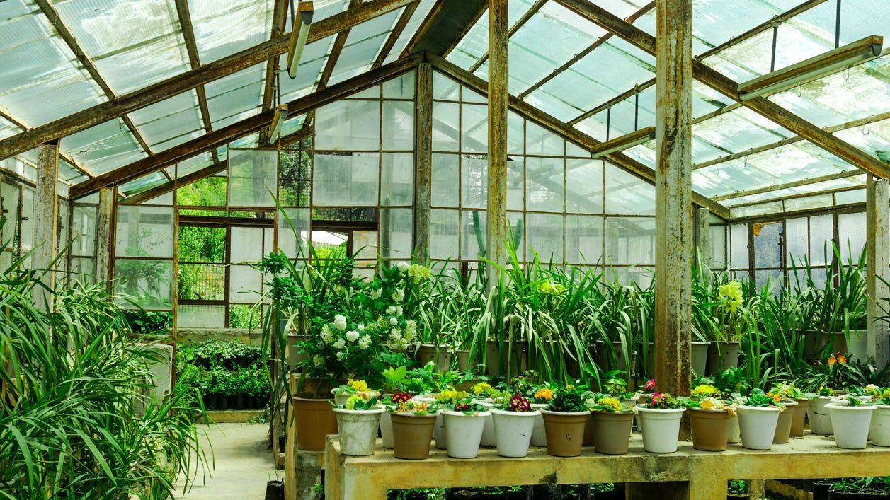
Climate & Temperature
Know your plants' "USDA hardiness zone"
  These zones help gardeners choose perennial plants, shrubs, and trees that will thrive year-round in their area
Protect them from extreme heat or cold (especially potted plants)
Use greenhouses or row covers in the cooler seasons
South Texas falls into the USDA Hardiness Zone 9a and 9b, which includes the Rio Grande Valley and the Gulf Coast areas
Website: USDA Plant Hardiness Zone Map
Notes:
Add hardiness zone and what works best

Slide 8
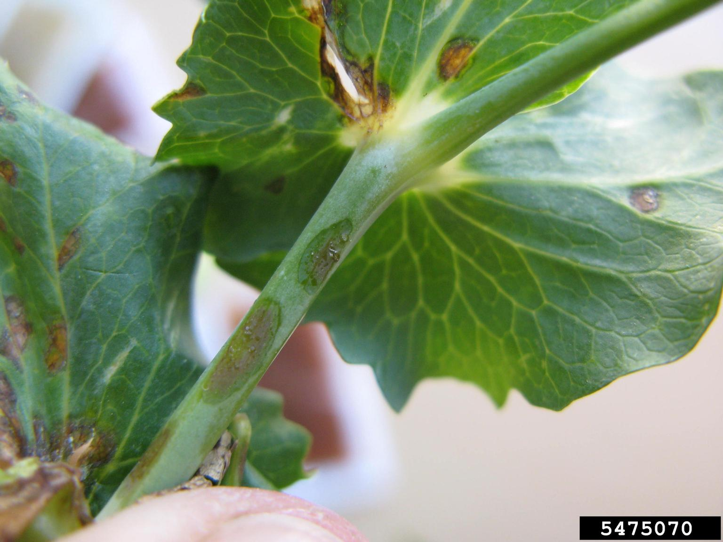
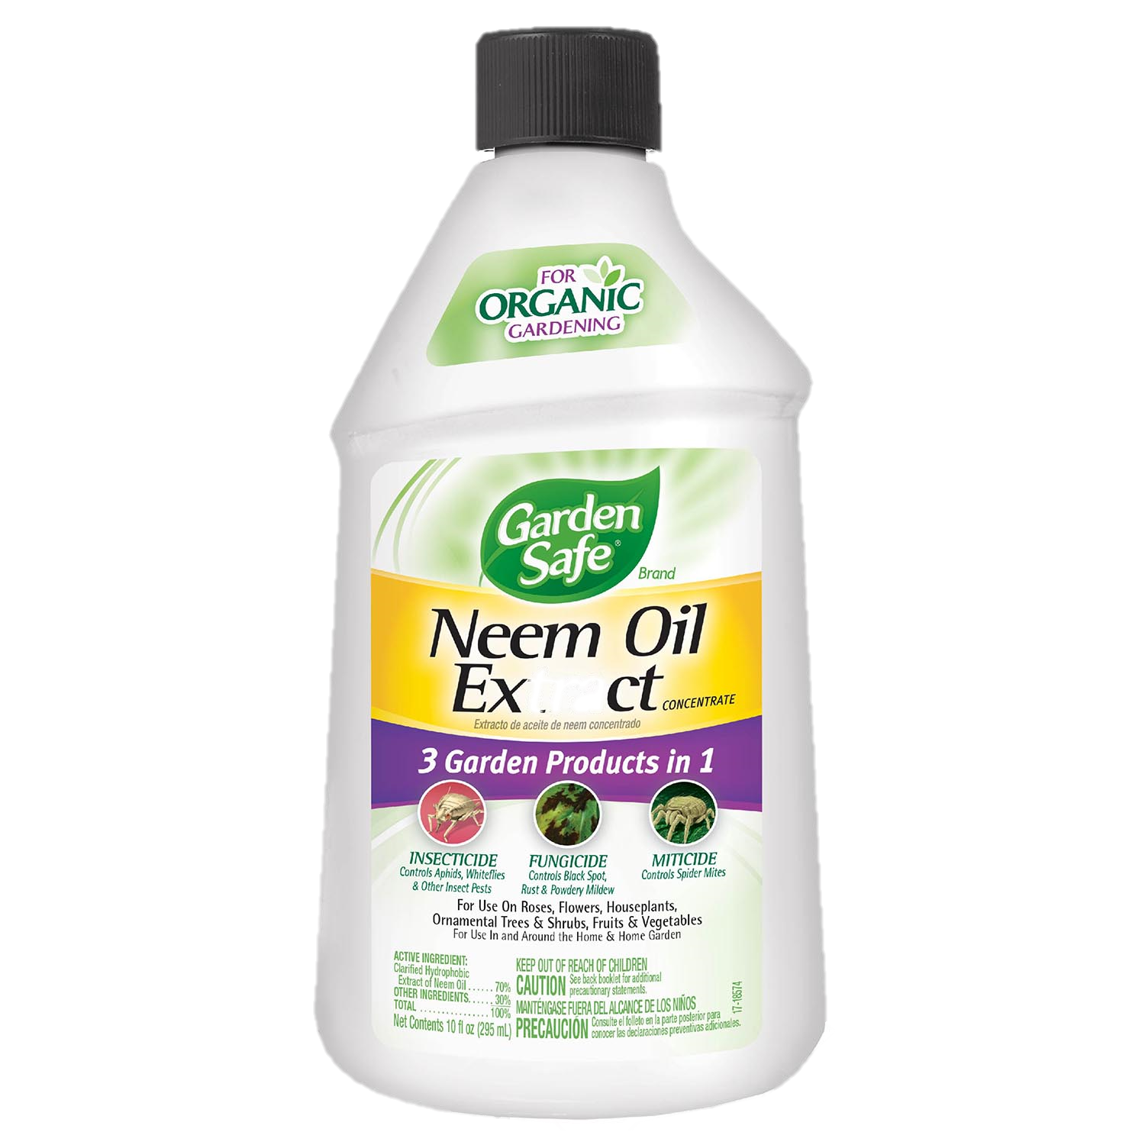
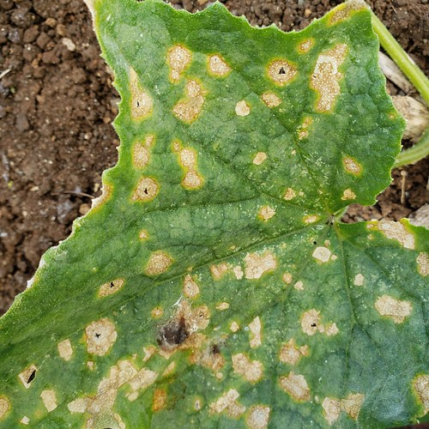
Protecting Your Plants
Regularly inspect leaves and stems
    Especially the underside of the leaves
Use natural remedies (e.g., neem oil or soap spray)
    Soap Spray:
      Best Ratio: 9:1 Water to Soap
Attract beneficial insects (ladybugs, bees)
Remove diseased leaves promptly and properly
This Photo by Unknown Author is licensed under CC BY
Notes:
Add ratio on soap spray
What attracts beneficial insects

Slide 9
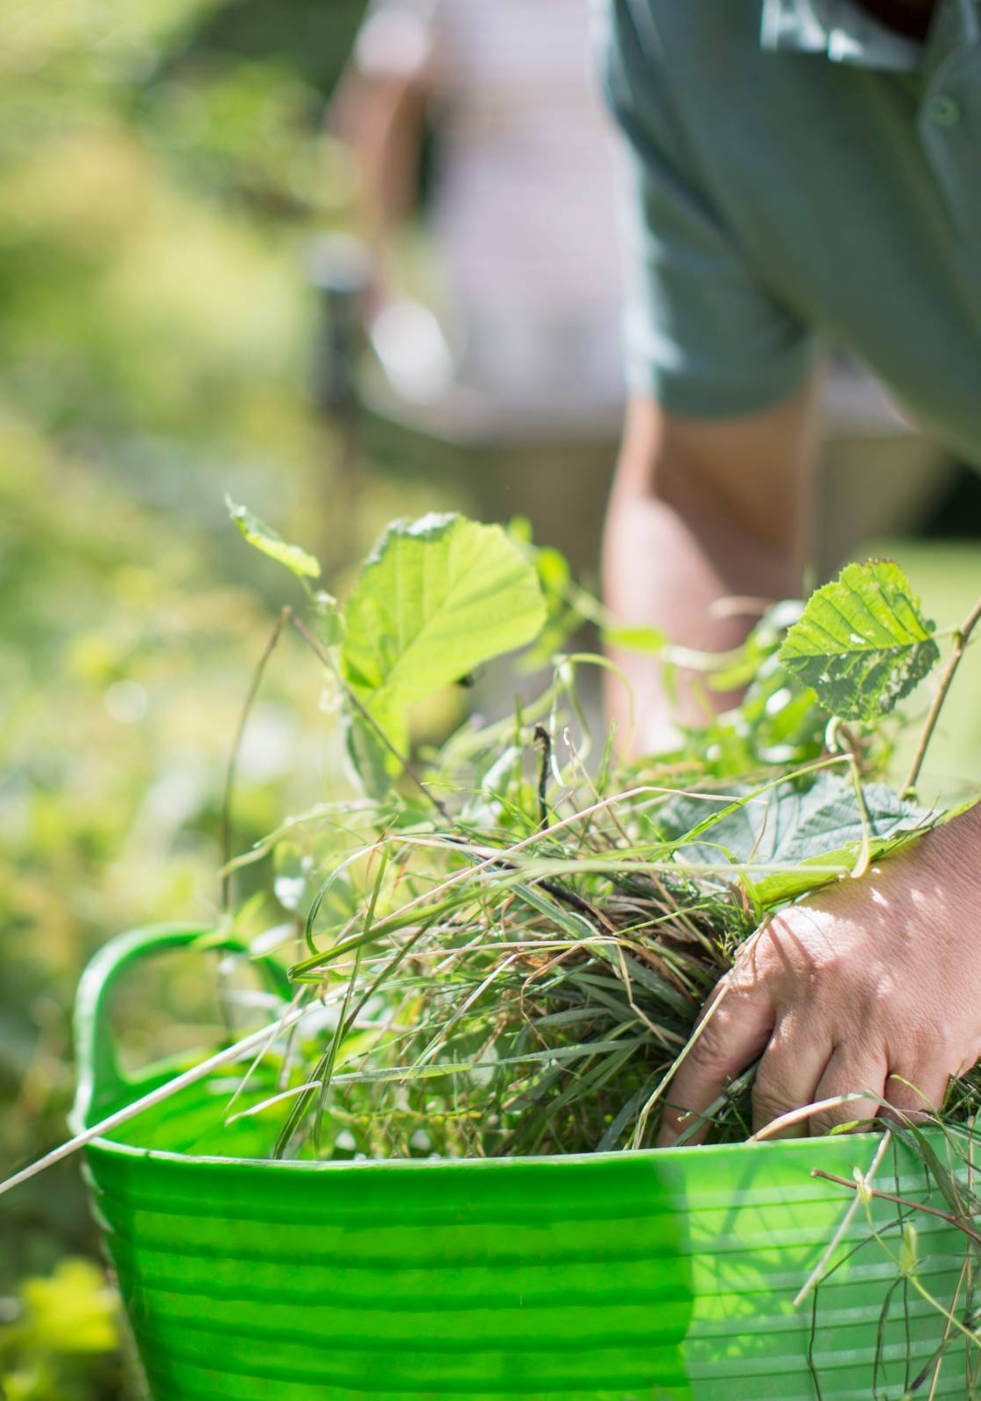
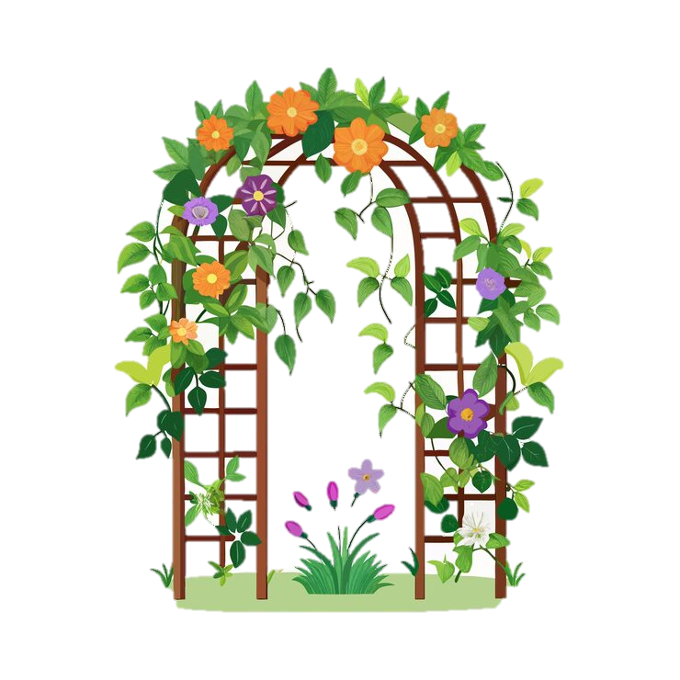
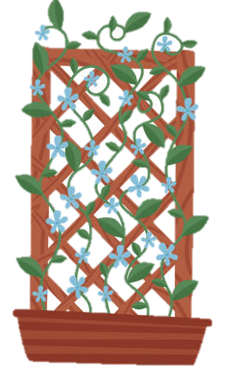
Trimming & Tending
Remove weeds and deadheads (spent flowers)
Prune to encourage new growth
  How to Prune Trees and Plants
Support climbing plants (trellises, cages)
Rotate crops seasonally to prevent soil depletion (for veggies only)

Slide 10
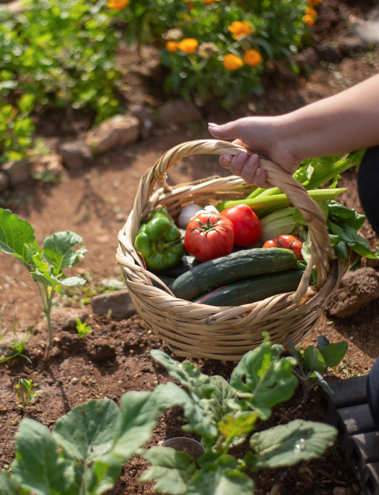
Seasonal Tips
Spring: Start seeds indoors, enrich soil
Summer: Water deeply, mulch more
Fall: Harvest, compost leaves
Winter: Protect perennials, plan for next season
Notes:
Add compost to soil

Slide 11
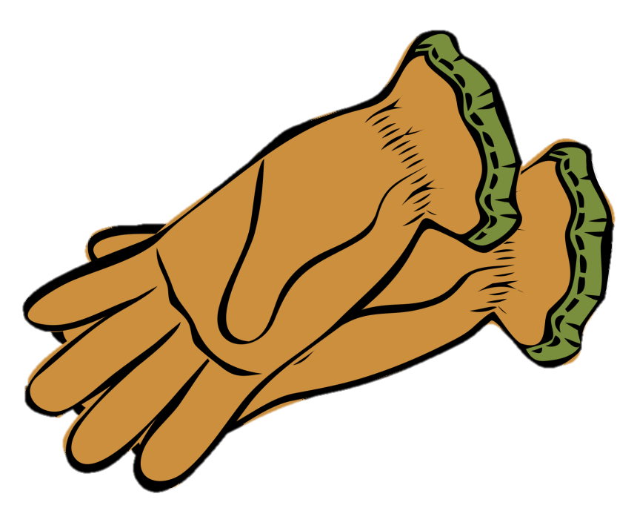

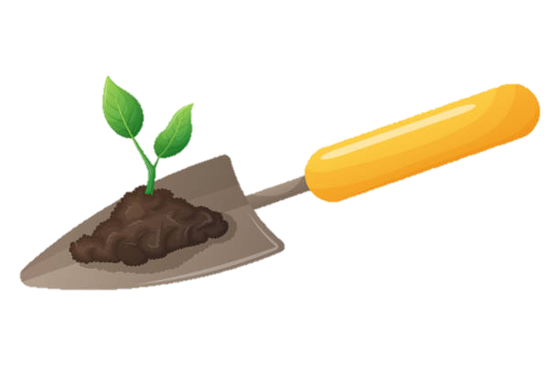
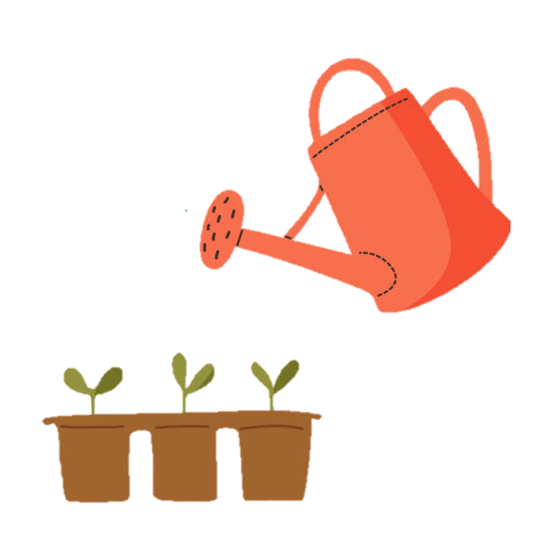
Tools & Equipment
Basic tools work just fine - no need for fancy equipment!
  Some of the basics: gloves, pruners, trowel, and a watering can
Optional tools: soil tester, compost bin, or grow lights
Make sure to keep your tools clean in between uses to avoid spreading pest and disease
  To clean garden tools, first brush or rinse off loose soil, then scrub remaining dirt with a wire brush or steel wool.
  For rust or sap, use a baking soda and vinegar paste, or soak in white vinegar or a bleach solution.
  After rinsing and thoroughly drying, disinfect with rubbing alcohol or a bleach solution to kill bacteria.
  Finish by applying a multi-purpose or plant-based oil to metal parts to prevent rust, and smooth wooden handles with linseed oil.

Slide 12


Quick Do’s & Don’ts
Do’s
Observe your plants regularly
Adjust care based on seasons
Keep a gardening journal
Don’ts
Overfertilize
Crowd plants
Ignore signs of stress (wilting, yellowing)

Slide 13
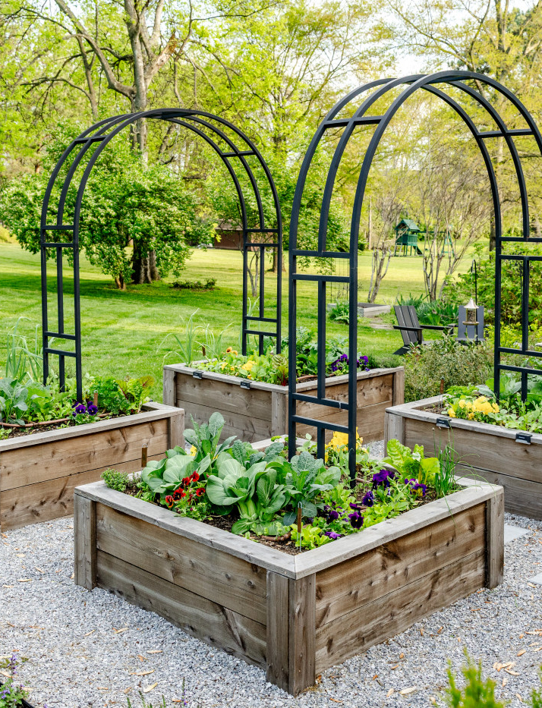
In Conclusion
Having patience and observation can lead to having a thriving garden - always start small and learn as you grow!
Gardening is not just about the plants, it’s also about your joy, sustainability and health.
Thank You,
Selena M Saenz
Environmental Educator
956.638.4530
selena.saenz@pharr-tx.gov

